Slide 1
SPACE
The Not-So-Final Frontier

Slide 2
The Evolution of Astronomer’s Tools
Astronomy began over 4000 years ago when people used their eyes to study the starts.
It helped them determine direction, the passing of seasons, and made them wonder about where we fit into the larger picture.

Slide 3
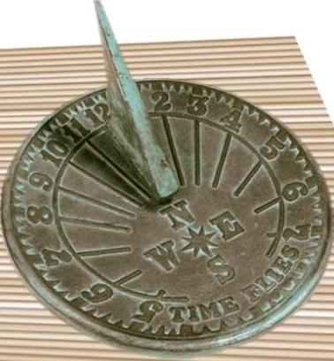
The Evolution of Astronomer’s Tools
In fact, Sundials have been used for over 7000 year to track the passing of time

Slide 4
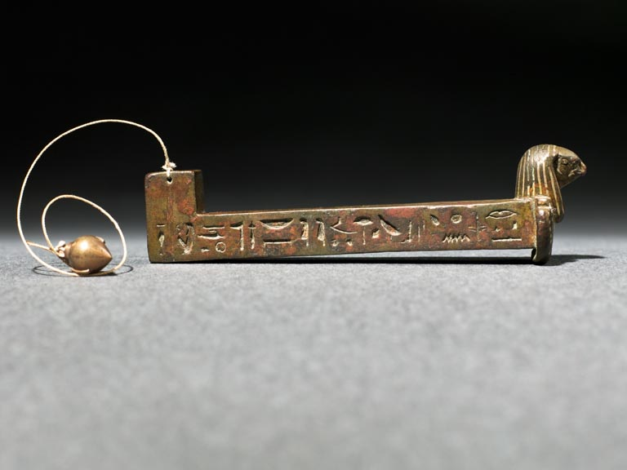
The Evolution of Astronomer’s Tools
Ancient Egyptians used the merkhet to chart the position of things in our night sky and to predict the movement of stars

Slide 5
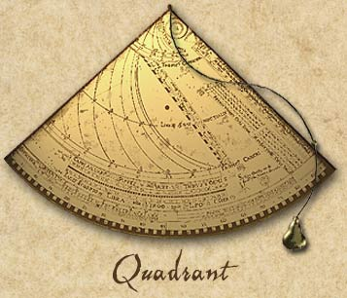
The Evolution of Astronomer’s Tools
Egyptians later used a quadrant to measure a star’s height above the horizon…we call this the star’s ???????.

Slide 6
The Evolution of Astronomer’s Tools
Egyptians later used a quadrant to measure a star’s height above the horizon…we call this the star’s altitude.

Slide 7
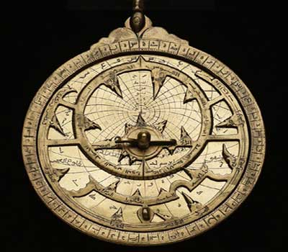
The Evolution of Astronomer’s Tools
Arabian astronomers used the astrolabe to chart the position of stars.

Slide 8
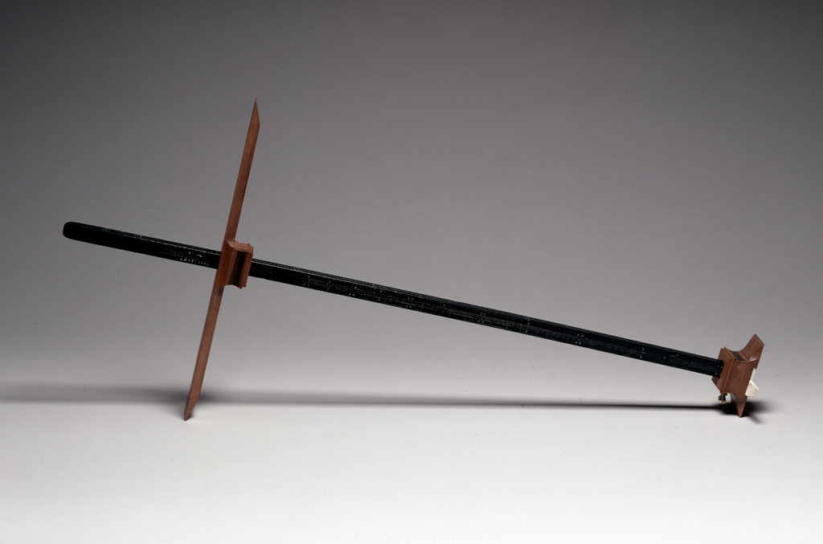
The Evolution of Astronomer’s Tools
In the 1300s, Levi ben Gerson invented the cross-staff to measure the angle between the moon and any given star.

Slide 9
The Evolution of Astronomer’s Tools
With each of these innovations, astronomers made new discoveries and gained more knowledge about what they were seeing.

Slide 10
The Telescope
The telescope was invented in the Netherlands in 1608. Soon after its invention, astronomers were using it to gaze at the stars. Most telescopes use mirrors and lenses to make objects appear closer than they are.

Slide 11
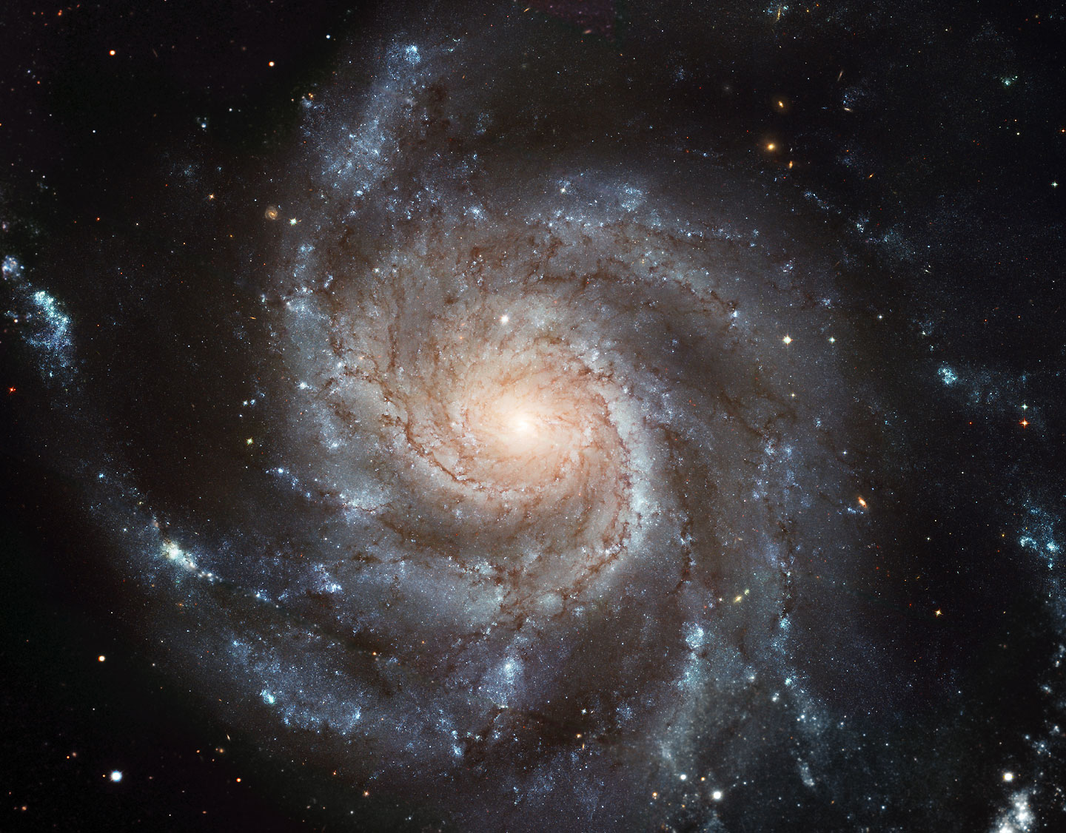
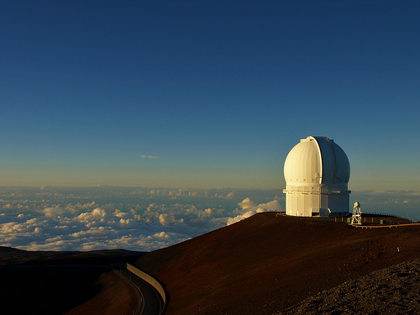
Ground-Based Optical Telescopes
Giant telescopes that are placed away from cities so they have a clearer view of the stars.

Slide 12
Ground-Based Optical Telescopes
But Ground-Based Optical Telescopes do not work well if the weather is poor. Clouds, wind, and even humidity affect how well a ground-based optical telescope will work.

Slide 13
Space-Based Optical Telescopes
Telescopes that are launched into space and orbit around the Earth. The view from these telescopes is not affected by Earth’s atmosphere and allow astronomers to see things that, to date, are impossible to see from Earth
(Read SBOT on pg 399)

Slide 14
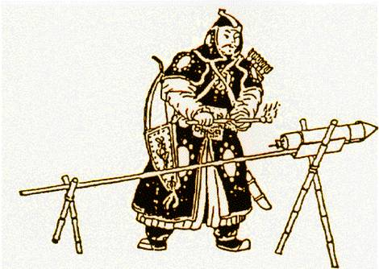
History of Space Travel
Chinese build the earliest known rockets in the 800s

Slide 15
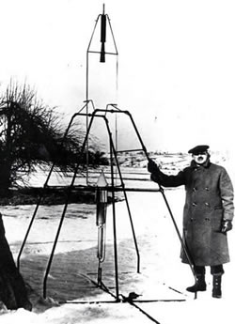
History of Space Travel
1926 – Americans launch the first liquid propelled rocket

Slide 16
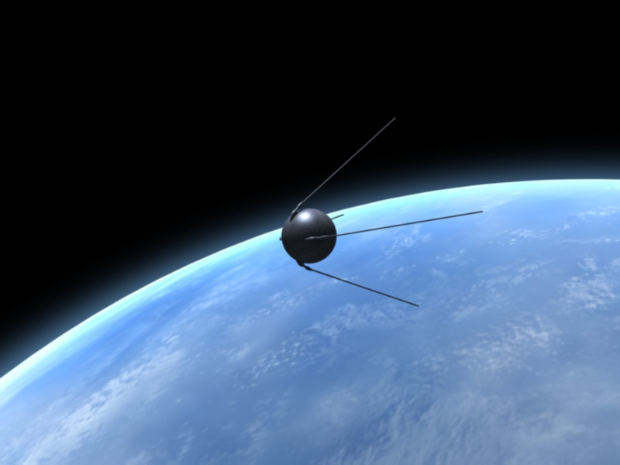
History of Space Travel
1957 – Soviet Union launches the first artificial satellite into Earth’s orbit (sputnik 1)
It was only the size of a football!

Slide 17
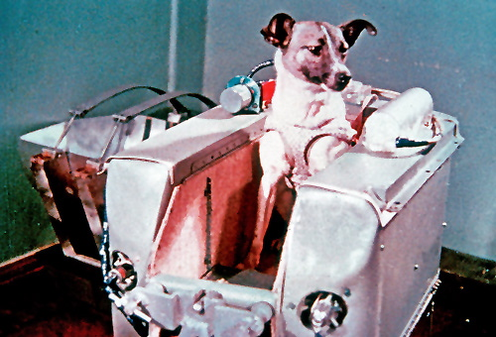
History of Space Travel
1957 – Soviet Union sends a dog into space named Laika (sputnik 2)

Slide 18
Many Students ask, what happened to Laika?
Little was known about the impact of spaceflight on living creatures at the time of Laika's mission, and the technology to de-orbit had not yet been developed, there was no expectation of Laika's survival. Some scientists believed humans would be unable to survive the launch or the conditions of outer space, so engineers viewed flights by animals as a necessary precursor to human missions.
Laika, a stray dog, underwent training with two other dogs, and was eventually chosen as the occupant of the Soviet spacecraft Sputnik 2 that was launched into outer space on November 3, 1957.
Laika probably died within hours after launch from overheating, possibly caused by a failure of the central R-7 sustainer to separate from the payload. The true cause and time of her death were not made public until 2002; instead, it was widely reported that she died when her oxygen ran out on day six. The experiment aimed to prove that a living passenger could survive being launched into orbit and endure weightlessness, paving the way for human spaceflight and providing scientists with some of the first data on how living organisms react to spaceflight environments.

Slide 19
History of Space Travel
1958 – NASA is created by president Eisenhower

Slide 20
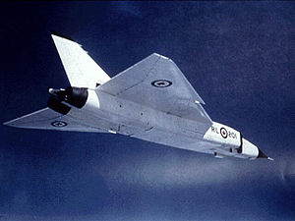
History of Space Travel
1958 – Canada produces the worlds fastest plane, as supersonic jet called the Avro Arrow

Slide 21
History of Space Travel
1959 – Soviet Union lands the first probe on the moon (Lunik II)

Slide 22
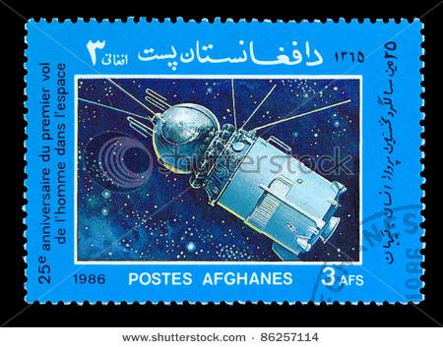
History of Space Travel
1961 – Soviet Union puts a cosmonaut in space, becomes the first person to orbit the Earth
(Yuri Gagarin in the Vostok I)

Slide 23
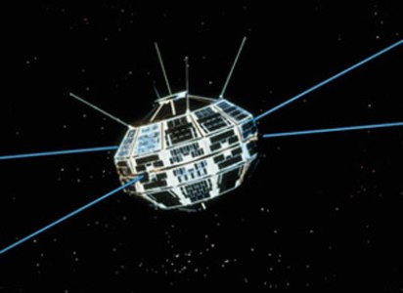
History of Space Travel
1962 – Canada puts the Alouette I satellite into space, marks Canada’s entry into the space age.

Slide 24
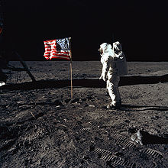
History of Space Travel
1969 – Americans land the first people on the moon (Apollo 11)

Slide 25
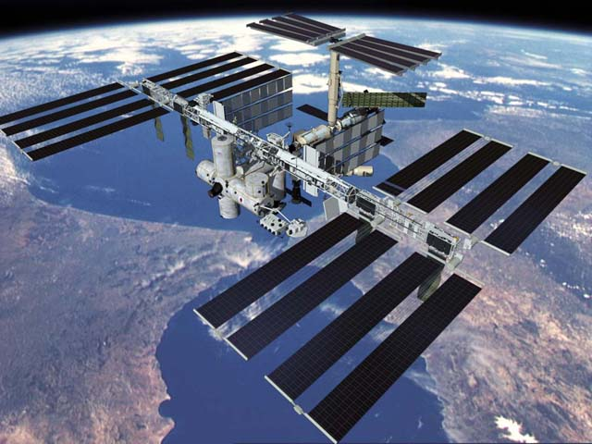
History of Space Travel
1998– The first segment of the International Space Station is launched.

Slide 26
History of Space Travel
It is the largest space craft ever built, orbiting 400km above the Earth’s surface

Slide 27
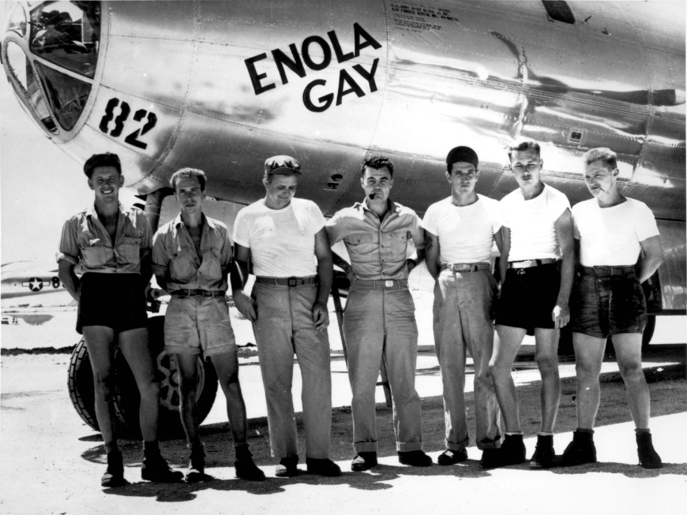
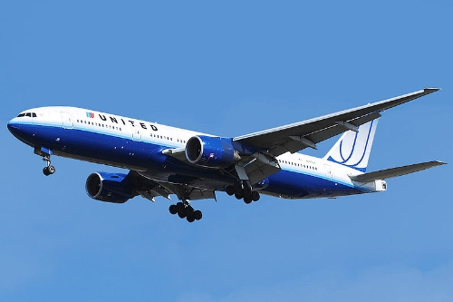
Spin off from Space Research
Faster airplane trips

Slide 28
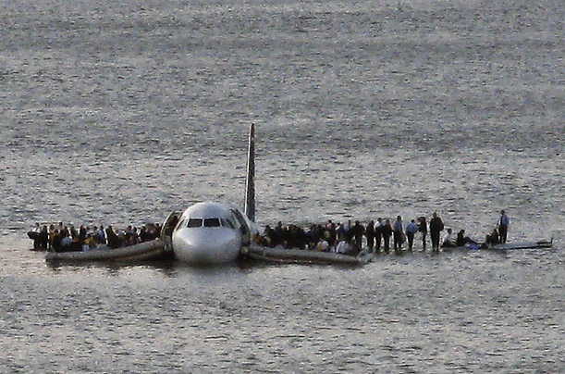
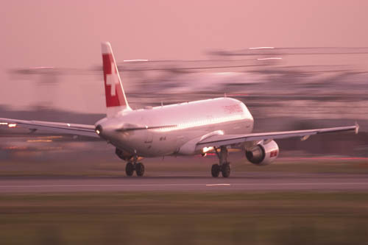
Spin off from Space Research
Safer airplanes

Slide 29
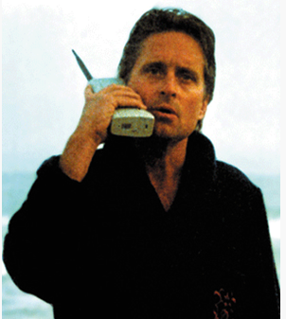
Spin off from Space Research
Cell phones

Slide 30
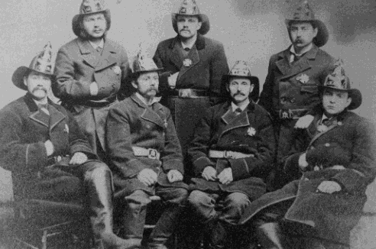
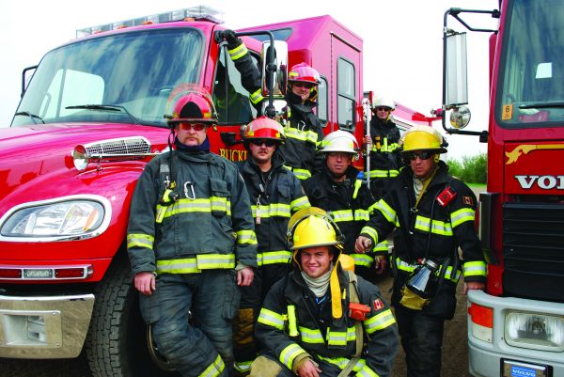
Spin off from Space Research
Improved firefighting equipment

Slide 31
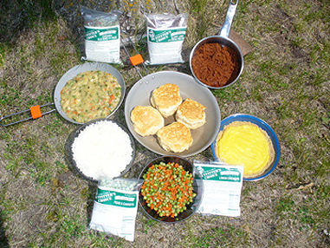
Spin off from Space Research
Production of portable camping/emergency food

Slide 32
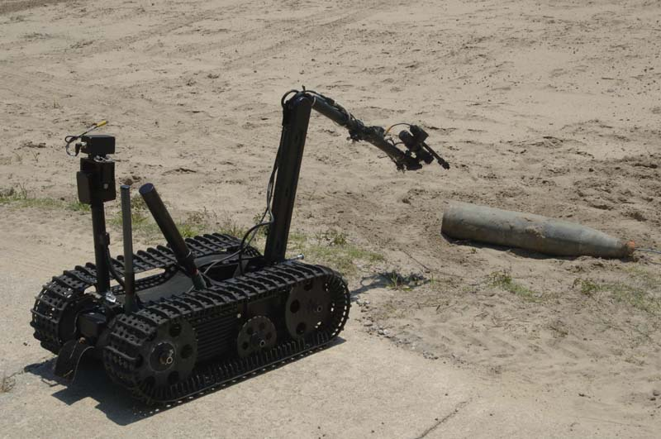
Spin off from Space Research
Robots that deal with explosives

Slide 33
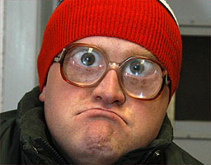
Spin off from Space Research
Scratch resistant lens coating for glasses

Slide 34
Spin off from Space Research
Water purification filters

Slide 35
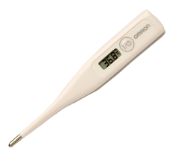
Spin off from Space Research
Digital thermometers

Slide 36
Spin off from Space Research
Household smoke detectors

Slide 37
Read
As we go through this as a class, we will make notes on each of the sections
Hazard of Travelling in Space (417)
Challenges of living in Space (418)
Challenges of Confined Living (418)
Challenges of Microgravity (419)

Slide 38
Hazards in Space
Intense solar radiation
Collisions with space debris
Could lose expensive materials
No atmosphere, limits on food, water, and air
Things are not easily fixed

Slide 39
Challenges of living in space
Microgravity
Cosmic rays and solar radiation
Stress due to confined spaces
Extreme heat in sun light and cold in shadows
Vacuum of space, no air and blood boils
Limited supplies (food & water)

Slide 40
Challenges of confined living
Stress cause by lack of space
Same people all the time (get sick of them)

Slide 41
Challenges of Microgravity
Heart weakens
Immune system weakens
Muscles weaken
Bones become weaker
Red blood cell production declines

Slide 42
Fin

